Slide 1


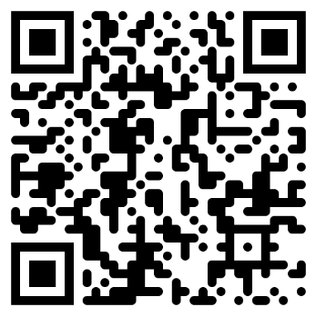
Morgan Lowe
morganwtlowe@gmail.com
+44 7982 939186

